Slide 1
Chapter 3
RDT

Slide 2




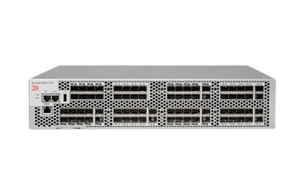

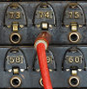
Transport layer functionality
Flow control
Congestion control
Multiplexing via sockets
7: Application
Application services
7: Application
7: Application
Inter-process comm.
Segmentation and reassembly
Error checking
Logical communications
4: Transport
4: Transport
4: Transport
3: Network
3: Network
3: Network
Reliability
In-order delivery
2: Data link
2: Data link
2: Data link
1: Physical
1: Physical
1: Physical
Notes:
How can messages get out of order?: different paths, retransmissions

Slide 3
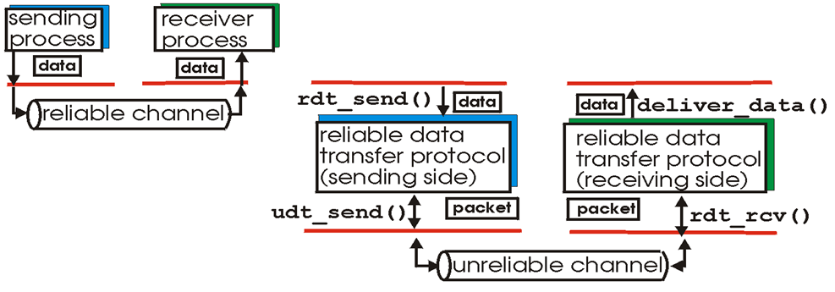

Principles of reliable data transfer
Provided Service
Service Implementation
Application
Transport
Network
Characteristics of unreliable channel will determine complexity of reliable data transfer protocol (rdt)
What are some ways in which the network channel can be unreliable?
Notes:
Loss, bit error, reordering, duplication

Slide 4


Slide 5
Bruce Lee FSM
Event causing state transition
Wait for ball
in_court(ball) == True
send_it(ball)
Actions taken on state transition

Slide 6
Principles of reliable data transfer
Provided Service
Service Implementation
Application
Transport
Network
Characteristics of unreliable channel will determine complexity of reliable data transfer protocol (rdt)
What are some ways in which the network channel can be unreliable?
Notes:
Loss, bit error, reordering, duplication

Slide 7
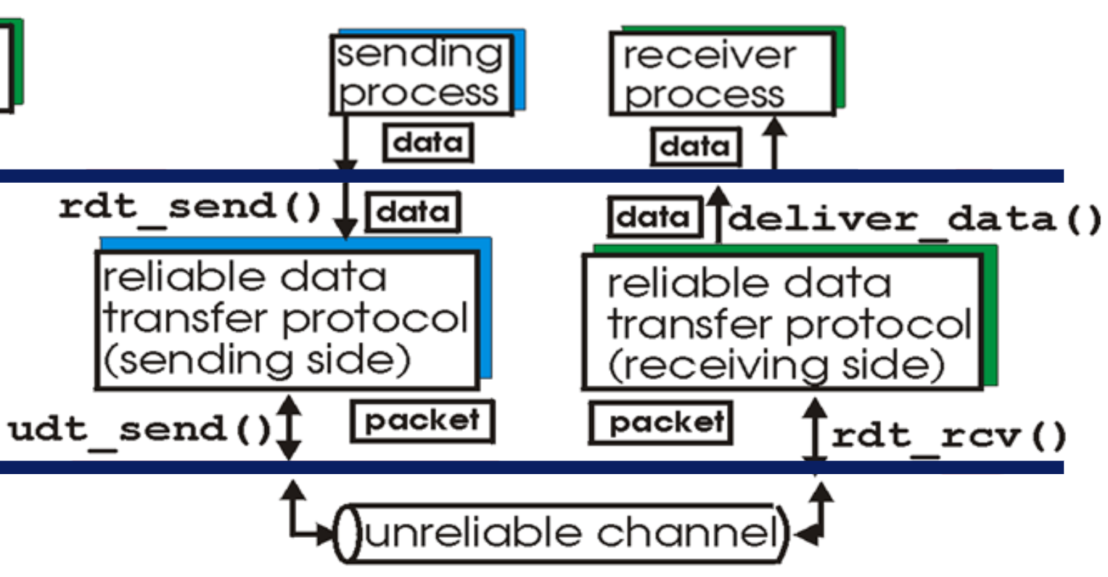
Reliable channel
rdt1.0: reliable transfer over reliable channel
Assumptions:
Unidirectional, long data flows
Perfectly reliable channel:
No bit errors
No packet loss
No packet reordering
Event causing state transition
Sender
Receiver
Wait for call from app
rdt_send(data)
Wait for call from network
rdt_rcv(packet)
packet = make_pkt(data)
udt_send(packet)
data = extract(packet)
deliver_data(data)
Actions taken on state transition

Slide 8
rdt2.0: Channel with bit errors
How are errors detected?
Checksums: make_pkt(data, checksum), corrupt(rcvpkt)
How do humans recover from communication errors?
ACKs, NAKs, and retransmissions: isACK(rcvpkt), isNAK(rcvpkt)
Design sender and receiver FSMs for rdt2.0
rdt1.0:
Sender
Receiver
Wait for call from appl
rdt_send(data)
Wait for call from network
rdt_rcv(packet)
packet = make_pkt(data)
udt_send(packet)
data = extract(packet)
deliver_data(data)

Slide 9
rdt2.0: Channel with bit errors
How are errors detected?
Checksums
How do humans recover from communication errors?
ACKs, NAKs, and retransmissions
Design sender and receiver FSMs for rdt2.0
Stop-and-wait: sender sends one packet, then waits for receiver response
Receiver
rdt_rcv(rcvpkt) && corrupt(rcvpkt)
rdt_send(data)
udt_send(NAK)
Sender
sndpkt = make_pkt(data, checksum)
udt_send(sndpkt)
Wait for call from net
rdt_rcv(rcvpkt) &&
isNAK(rcvpkt)
Wait for ACK or NAK
Wait for call from appl
udt_send(sndpkt)
rdt_rcv(rcvpkt) && !corrupt(rcvpkt)
rdt_rcv(rcvpkt) && isACK(rcvpkt)
data = extract(packet)
deliver_data(data)
udt_send(ACK)
Λ
Notes:
What are some problems with this protocol?
Same packet could be delivered twice (if NACK instead of ACK received after a bit error)
Sender could stop if not ACK/NACK → no, something would be delivered

Slide 10
rdt2.0: Channel with bit errors
What happens if ACK/NAK corrupted?
Duplicate delivery, or no retransmission when needed
How can we deal with corrupted ACKs/NAKs?
Retransmission, but can get duplicate packets
How to handle duplicate packets?
Embed sequence numbers in packets: make_pkt(seq_num, data, checksum), get_seq_num(rcvpkt)
Only need 0 and 1 for seq_num. Why?
Come up with sender and receiver FSMs for rdt2.0 with sequence numbers and retransmissions
Receiver
rdt_rcv(rcvpkt) && corrupt(rcvpkt)
udt_send(NAK)
Sender
rdt_send(data)
Wait for call from net
sndpkt = make_pkt(data, checksum)
udt_send(sndpkt)
rdt_rcv(rcvpkt) &&
isNAK(rcvpkt)
Wait for ACK or NAK
rdt_rcv(rcvpkt) && !corrupt(rcvpkt)
Wait for call from appl
udt_send(sndpkt)
data = extract(packet)
deliver_data(data)
udt_send(ACK)
rdt_rcv(rcvpkt) && isACK(rcvpkt)
Λ
Notes:
What happens if ACK/NAK corrupted?
sender doesn’t know what happened at receiver!
can’t just retransmit: possible duplicate
Handling duplicates:
sender retransmits current pkt if ACK/NAK corrupted
sender adds sequence number to each pkt
receiver discards (doesn’t deliver up) duplicate pkt

Slide 11
rdt2.1: sender, handles garbled ACKs
rdt_send(data)
sndpkt = make_pkt(0, data, checksum)
udt_send(sndpkt)
rdt_rcv(rcvpkt) &&
(corrupt(rcvpkt) || isNAK(rcvpkt))
Wait for call from appl
Wait for ACK or NAK 0
udt_send(sndpkt)
rdt_rcv(rcvpkt)
&& notcorrupt(rcvpkt)
&& isACK(rcvpkt)
rdt_rcv(rcvpkt)
&& ! corrupt(rcvpkt)
&& isACK(rcvpkt)
Λ
Wait for ACK or NAK 1
Wait for
call from appl
Λ
rdt_rcv(rcvpkt) &&
(corrupt(rcvpkt) ||
isNAK(rcvpkt))
rdt_send(data)
sndpkt = make_pkt(1, data, checksum)
udt_send(sndpkt)
udt_send(sndpkt)

Slide 12
rdt2.1: receiver, handles garbled ACKs
Deliver data only once
rdt_rcv(rcvpkt) && !corrupt(rcvpkt)
&& get_seq_num(rcvpkt) == 0
data = extract(packet)
deliver_data(data)
sndpkt = make_pkt(ACK,chksum)
udt_send(sndpkt)
rdt_rcv(rcvpkt) && corrupt(rcvpkt)
rdt_rcv(rcvpkt) && corrupt(rcvpkt)
sndpkt = make_pkt(NAK,chksum)
udt_send(sndpkt)
sndpkt = make_pkt(NAK,chksum)
udt_send(sndpkt)
Wait for network
Wait for
network
rdt_rcv(rcvpkt) &&
not corrupt(rcvpkt) &&
get_seq_num(rcvpkt) == 1
rdt_rcv(rcvpkt) &&
!corrupt(rcvpkt) &&
get_seq_num(rcvpkt) == 0
rdt_rcv(rcvpkt) && !corrupt(rcvpkt) && get_seq_num(rcvpkt) == 1
sndpkt =
make_pkt(ACK,chksum)
udt_send(sndpkt)
sndpkt = make_pkt(ACK,chksum)
udt_send(sndpkt)
data = extract(packet)
deliver_data(data)
sndpkt = make_pkt(ACK,chksum)
udt_send(sndpkt)
Loop on duplicates
Notes:
receiver:
must check if received packet is duplicate
state indicates whether 0 or 1 is expected pkt seq #
note: receiver can not know if its last ACK/NAK received OK at sender

Slide 13
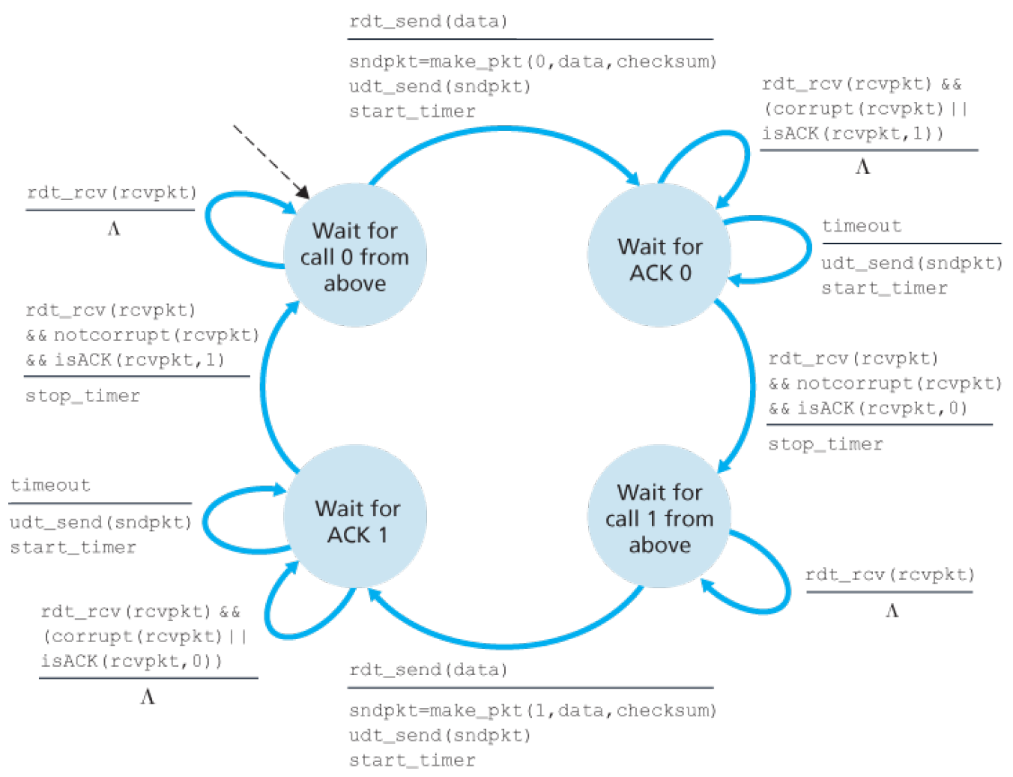
rdt3.0: bit errors and loss
New assumption:
packet loss
How do we know a loss has occurred?
What can we do about it?
Approach:
Sender waits “reasonable” amount of time for ACK
Retransmits packet if no ACK received in this time
What if packet/ACK only delayed?
Duplicate packets ignored at the receiver through sequence numbers
Receiver specifies sequences number of ACKed packet

Slide 14
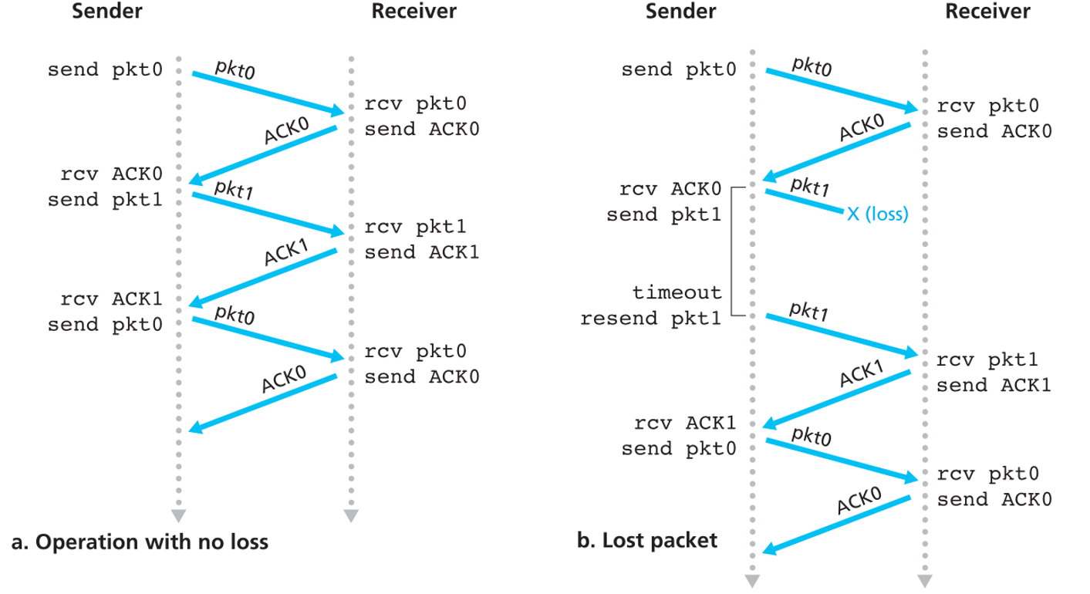
rdt3.0 in action

Slide 15
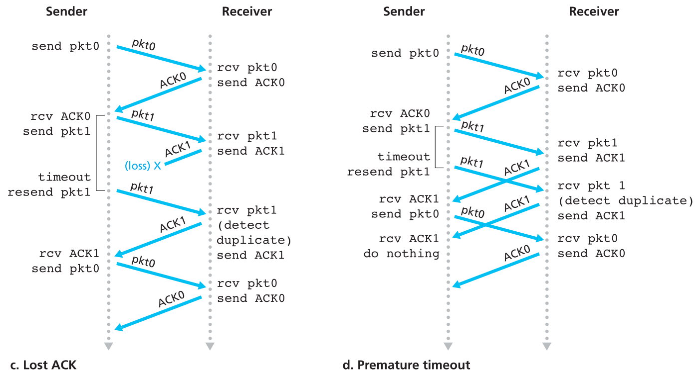
rdt3.0 in action

